Slide 1
Sensory Physiology II
Afferent Pathways
Dr. Deepthi de Silva
Department of Physiology

Slide 2
At the end of this lecture, you should be able to
State the types of neurons that are involved in transmitting different sensory modalities
Outline the pathway of the dorsal column – medial lemniscal system
State the main sensory modalities transmitted by this system
Outline the pathway of the anterolateral (spinothalamic) system
State the main sensory modalities transmitted by this system

Slide 3
Afferent nerves (sensory information)
Fibre type | Sensory modality | Fibre size (μm) | Conduction velocity (ms)
Aα | Proprioception | 12-20 | 70-120
Aβ | Touch, pressure, | 5-12 | 30-70
Aδ | Pain & cold Touch | 2-5 | 12-30
C | Pain, cold & hot Touch | 0.4-1.2 | 0.5-2

Slide 4
Sensory Pathways
Dorsal Column- Medial Lemniscal System
Rapid transmission
  Large myelinated fibres
Accurate localisation
  high spatial orientation of fibres
Mechanoreceptor sensations only
  Proprioception
  Touch, pressure (vibration)
Anterolateral System
Slower transmission
  Smaller myelinated fibres
Less accurate localisation
Broad range of sensory modalities
  Pain & temperature
  Crude touch
  Itch, tickle, sexual

Slide 5
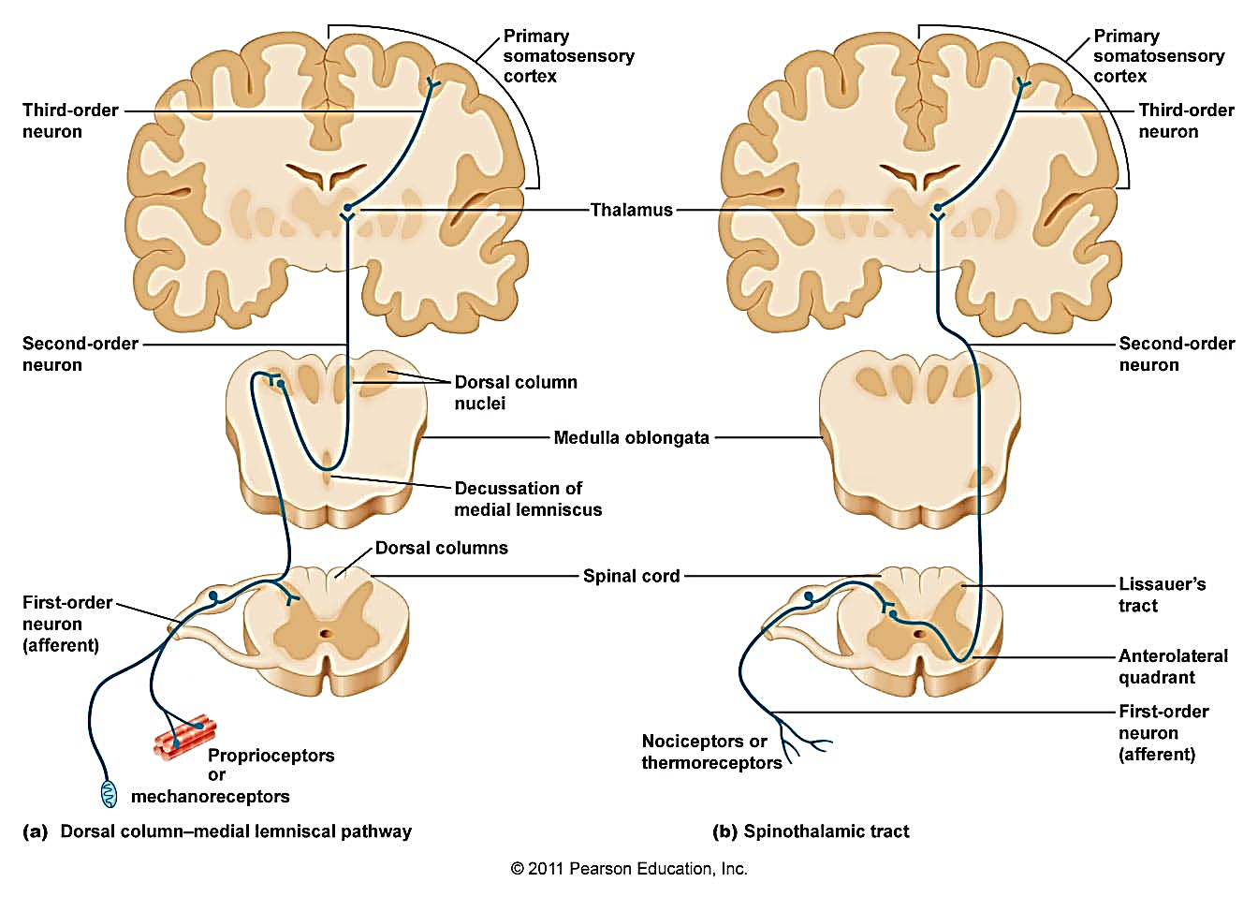

Slide 6
Dorsal Column- Medial lemniscal system
Touch sensation required for
  Accurate localisation
  Accurate grading of intensity
  Accurate determination of pressure
  Detecting rapid movement against skin
  Rapidly changing touch/ pressure e.g. vibration
Position sensation

Slide 7
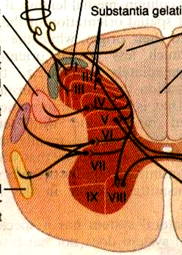
Sensory afferents (large myelinated)
1st order neurone
Spinal nerves
Dorsal
column
Dorsal Roots
Ascends via
ipsilateral
dorsal column
Ventral & dorsal
Spinocerebellar
tracts

Slide 8
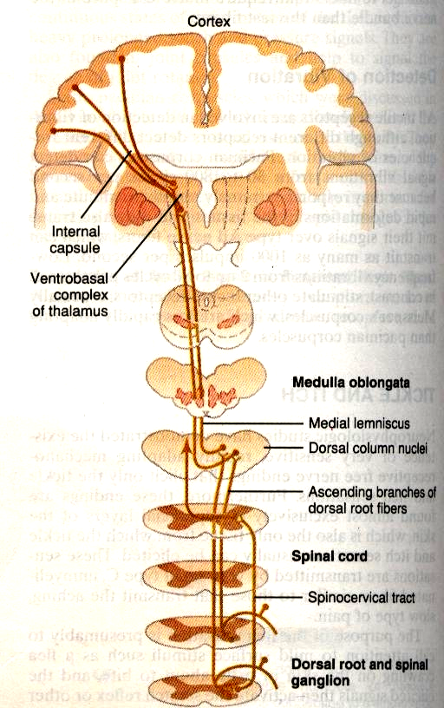
Dorsal column
Medial
Lemniscus
Medulla Oblongata
Dorsal Column nuclei in medulla
[Nucleus cuneate & gracile]
Fasciculi gracilis &
cuneatus
[dorsal column]
2nd order neurons decussate (cross to opposite side)
Spinal cord
Dorsal root
Spinal ganglion
Ascends as medial lemnisci (to thalamus)

Slide 9
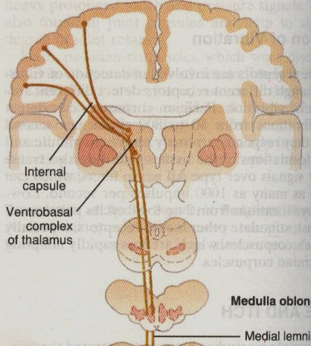
Medial lemnisci
Fibres from sensory nuclei of trigeminal nerve
Ventral Posterior Lateral (VPL) nucleus of Thalamus
Thalamic
radiation
Ventrobasal
complex
of thalamus
3rd order neurons
Cerebral cortex
(somatosensory areas
I & II)
Medial
lemnisci

Slide 10
Anterolateral System (Spinothalamic Tract)
Pain
Temperature
Crude touch
Tickle & itch
Sexual sensations

Slide 11
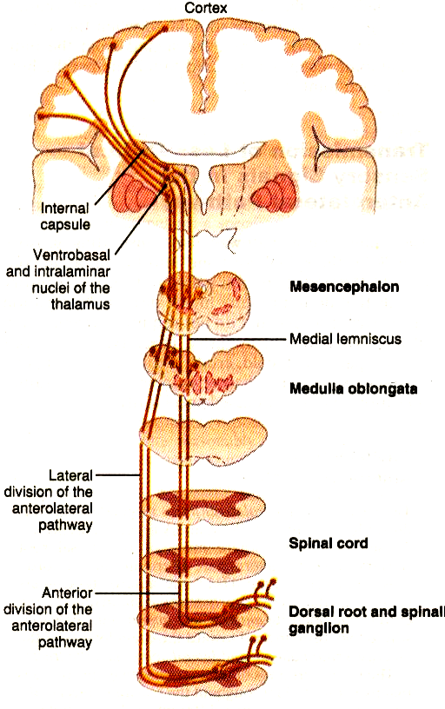
Medulla
Spinal neurons via dorsal roots
Lateral
spino
thalamic
tract
Dorsal Horn
2nd order neurons
cross to opposite side
Anterior
spino
thalamic
tract
Ascends in white column of spinal cord
Dorsal root
Spinal
ganglion
Anterior spinothalamic tract
Lateral spinothalamic tract

Slide 12
Anterior and lateral spinothalamic tracts
Thalamic
radiation
Thalamus
Brain stem
Ventral Posterior Lateral (VPL) nucleus of Thalamus
Ventrobasal complex
Thalamus
Medial
Lemniscus
Cerebral cortex
(somatosensory areas
I & II)

Slide 13
Lamination of Spinal cord tracts
Gracile
fasciculus
Cuneate
fasciculus
Lumbar
Thoracic
Dorsal column
  fibres get pushed medially
Spinothalamic tract
  Fibres get pushed laterally
Sacral
Cervical
S L T C
S L T C

Slide 14
Fibres in the dorsal column pathway maintain their organisation as they are transmitted through the medulla, thalamus and cortex
Organisation is less specific in the anterolateral system

Slide 15
Can you?
State the types of neurons that are involved in transmitting different sensory modalities
Outline the pathway of the dorsal column – medial lemniscal system
State the main sensory modalities transmitted by this system
Outline the pathway of the anterolateral system
State the main sensory modalities transmitted by this system

